Slide 1



Design and Development of LLC Resonant Converter for EV charging
( MTP - Stage 1 )
Aditya Kumar
Guide: Prof. Siddavatam Ravi Prakash Reddy
Electrical Machines & Power Electronic Systems (EMPES) Lab
Department of Energy Science and Engineering
Indian Institute of Technology Bombay

Slide 2

Objective
Theoretical Part
FHA Analysis
Voltage Gain Curves
Hardware Part
Transformer Characterization
Series Resonant Converter (SRC)
LLC Resonant Converter
Operating Modes
Design Parameters

Slide 3
LLC Converter Specifications
Parameter | Value
Input voltage (Vin) | 60 V
Output voltage (Vout) | 6 V
Resonant tank Inductance (Lr) | 800 µH
Resonant tank capacitor (Cr) | 90 nF
Magnetising Inductance (Lm) of T/F | 3.78 mH
Resonant frequency (fr) | 18 kHz
Output capacitor (C) | 430 µF
Switches and Diodes | Ideal

Slide 4
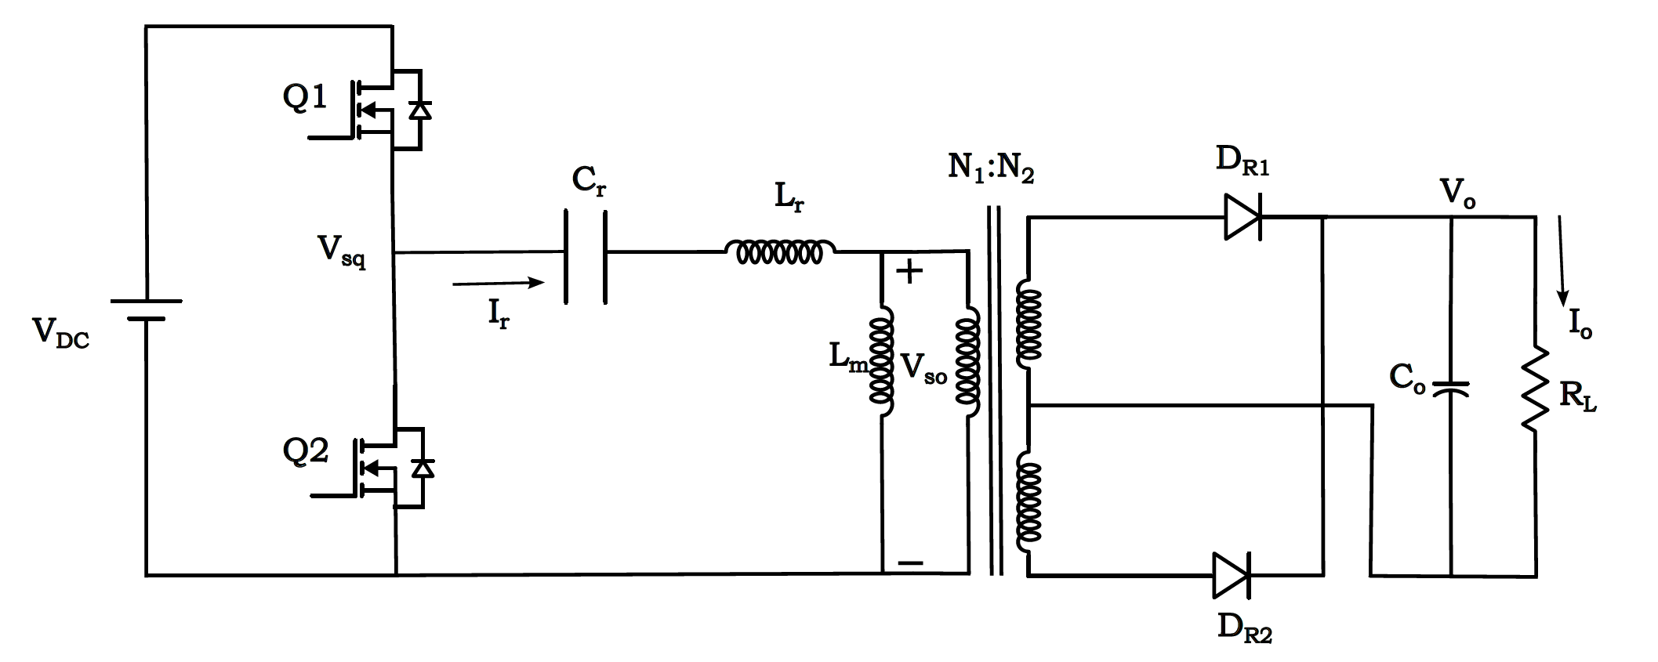
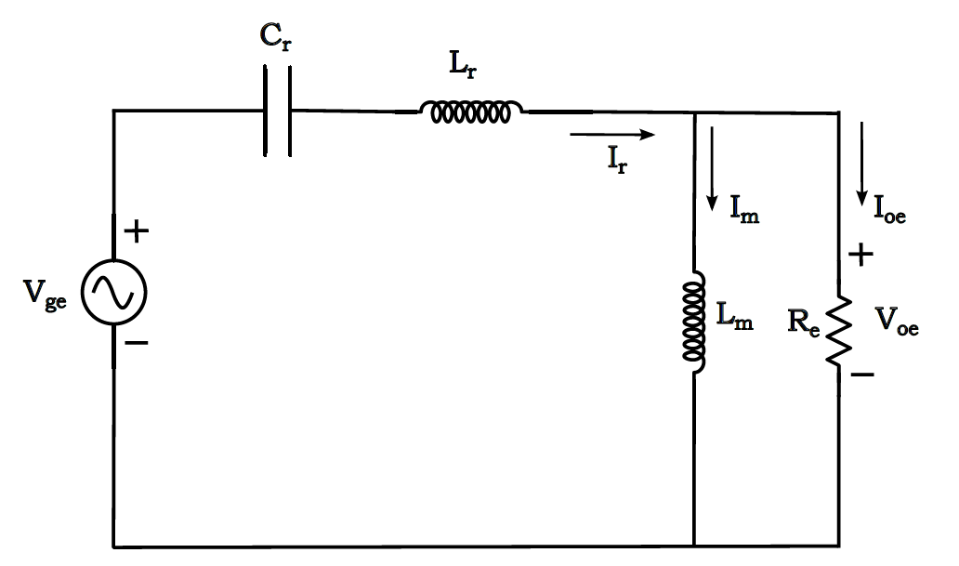

LLC Resonant Converter
Equivalent resistance
$$R_{eq}= \frac{8R}{π^{2}}∗{\left(\frac{N_{1}}{N_{2}}\right)}^{2}$$
Resonant frequency
$$f_{r}= \frac{1}{2π\sqrt{L_{r}C_{r}}}$$
Pole frequency
$$f_{p}= \frac{1}{2π\sqrt{{(L}_{r}+L_{m})C_{r}}}$$
Voltage gain (FHA)
$M_{g}$ = $\frac{V_{oe}}{V_{ge}}$ = $\frac{L_{n}{ f}_{n}^{2}}{\sqrt{{ [\left(L_{n} + 1\right)f_{n}^{2} − 1]}^{2}+ {[(f_{n}^{2} − 1){ L}_{n}{ Q}_{e}{ f}_{n} ]}^{2}}}$
where- $f_{n}= \frac{f_{s}}{f_{r}}$
Equivalent circuit

Slide 5
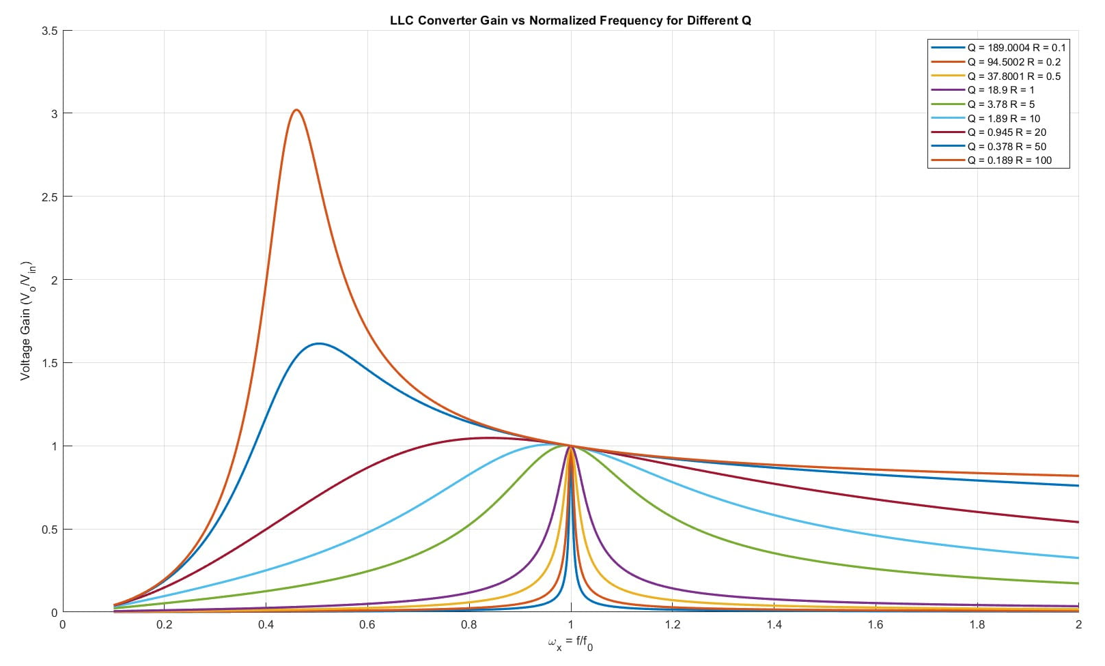
Gain vs. switching frequency curve
Light load
(R = 100Ω)
Heavy load
(R = 0.1Ω)
@ Ln = 4

Slide 6


Key Observations and Inferences
For fs = fr
Gain = 1 (for all Q)
For fs > fr
Gain < 1
Can act as Buck or Boost converter
Loading independent operation at fr
Peak doesn’t necessarily occur at fr
Even at no load, output voltage can be regulated easily. (drawback of SRC)
SRC:-
G = $\frac{V_{o}}{V_{in}}$ = $\frac{1}{\sqrt{1 + Q_{e}^{2}{ \left(\frac{ω_{s}}{ω_{r}} − \frac{ω_{r}}{ω_{s}}\right)}^{2}}}$
What if the tank parameters are changed

Slide 7
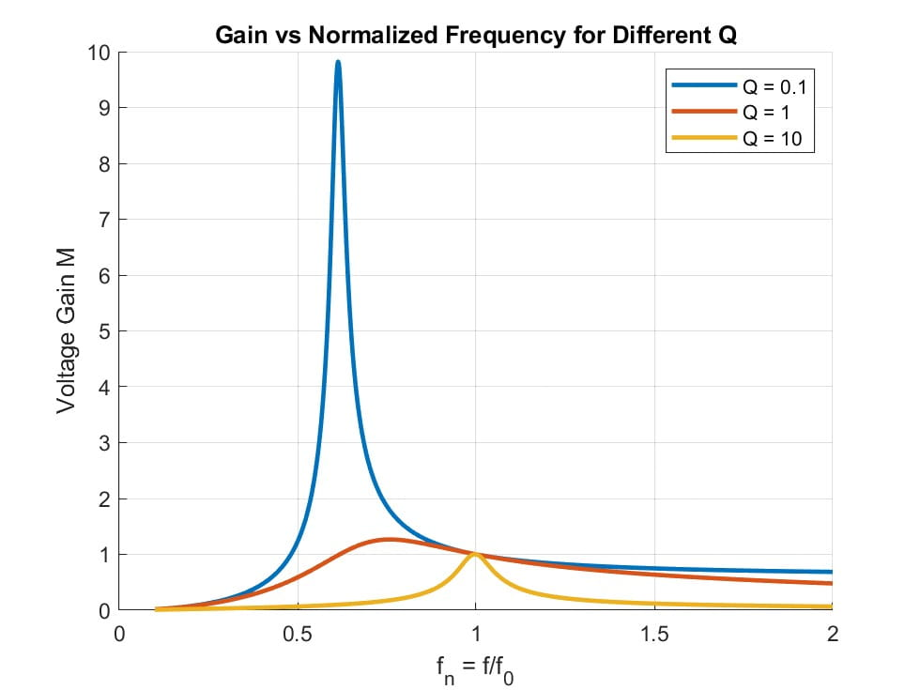
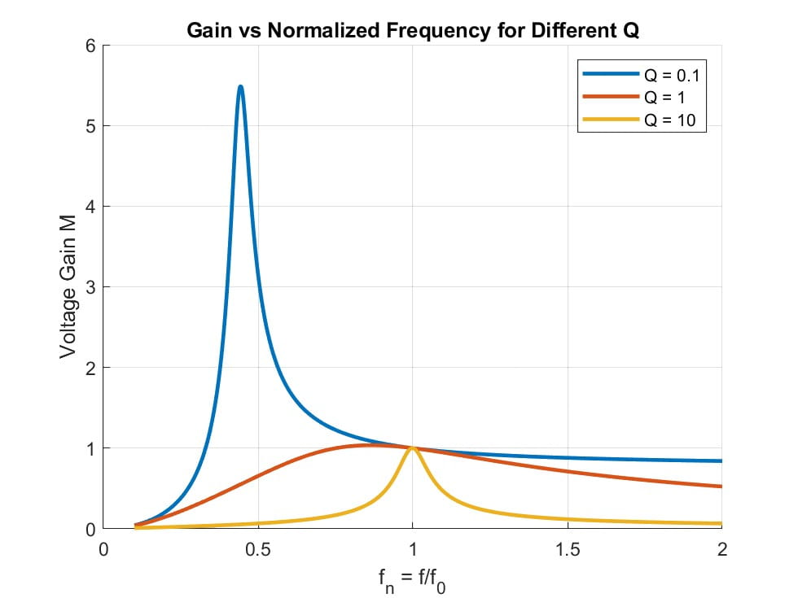
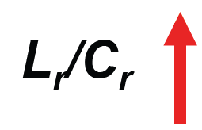
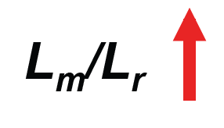
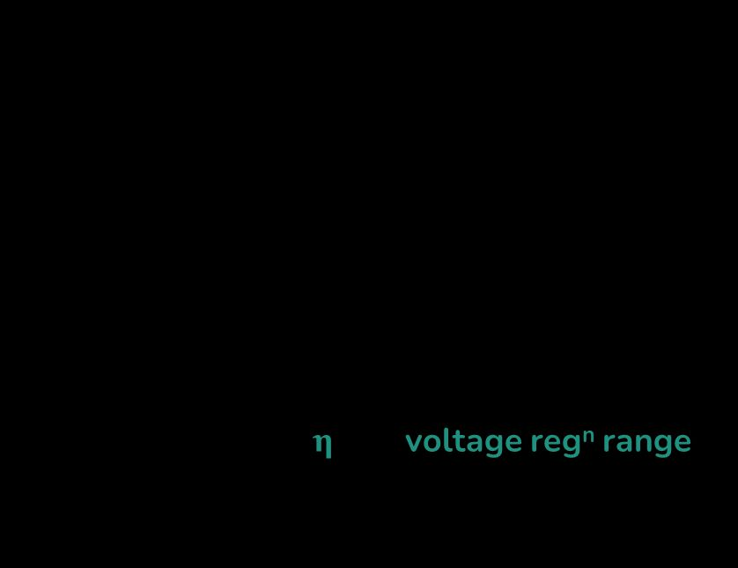
Variation in Resonant Tank Parameters
As $\frac{L_{m}}{L_{r}}$ increases – Gain decreases (less)
As $\frac{L_{r}}{C_{r}}$ increases – Gain decreases (much)
& ∆f increases
So, we can say that both $\frac{L_{m}}{L_{r}}$ and $\frac{L_{r}}{C_{r}}$ ratios
should be low enough.
If we reduce $L_{m}$ for wide voltage regulation - $I_{Lm}$ increases – Poor η
So, trade-off b/w η and voltage reg^{n} range
Cr = 22 nF
Lr = 150 µH
Lm = 250 µH
Cr = 22 nF
Lr = 60 µH
Lm = 250 µH
Cr = 10 nF
Lr = 150 µH
Lm = 250 µH
Cr = 10 nF
Lr = 60 µH
Lm = 250 µH
∆f
Notes:
Gain reduction – So voltage regulation range is reduced. (we don’t want)
Del f increases – So operational frequency variation increases. (we don’t want)
1 → 0.145 fo = 7.25 kHz and
3 → 0.247 fo = 12.35 kHz (for fo = 50 kHz)

Slide 8

Key Observations
As $\frac{L_{m}}{L_{r}}$ increases – Gain decreases (less)
As $\frac{L_{r}}{C_{r}}$ increases – Gain decreases (much)
& ∆f increases
So, we can say that both $\frac{L_{m}}{L_{r}}$ and $\frac{L_{r}}{C_{r}}$ ratios
should be low enough.
If we reduce $L_{m}$ for wide voltage regulation - $I_{Lm}$ increases – Poor η
So, trade-off b/w η and voltage reg^{n} range
∆f
Notes:
Gain reduction – So voltage regulation range is reduced. (we don’t want) Del f increases – So operational frequency variation increases. (we don’t want)

Slide 9
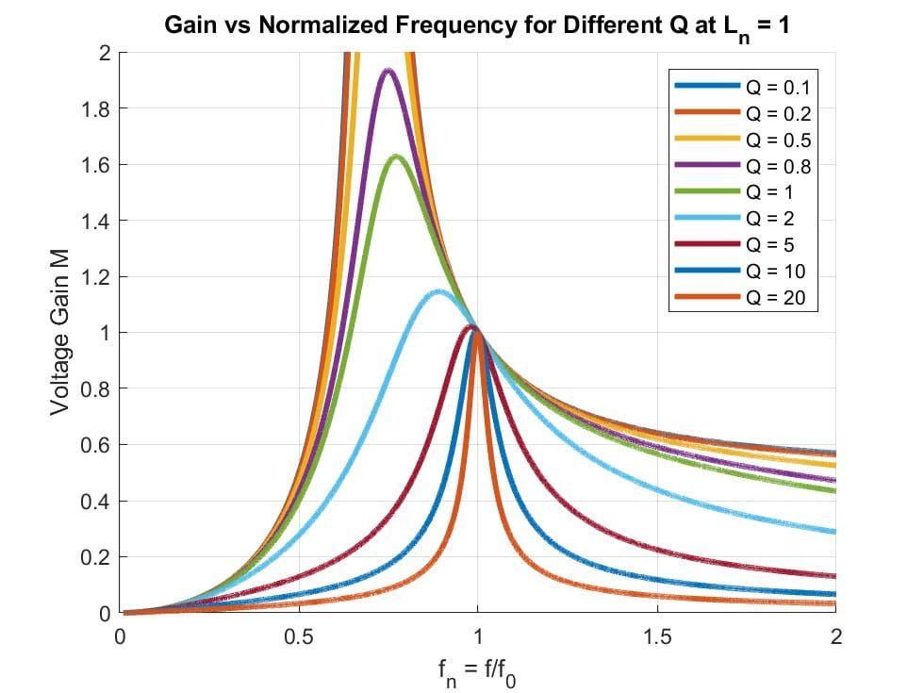
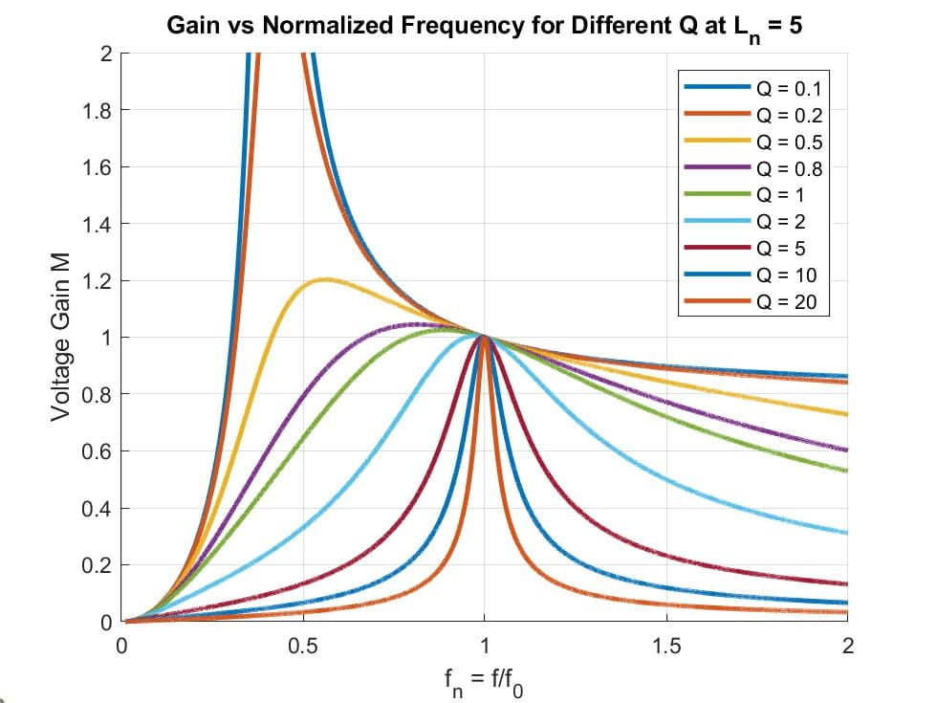
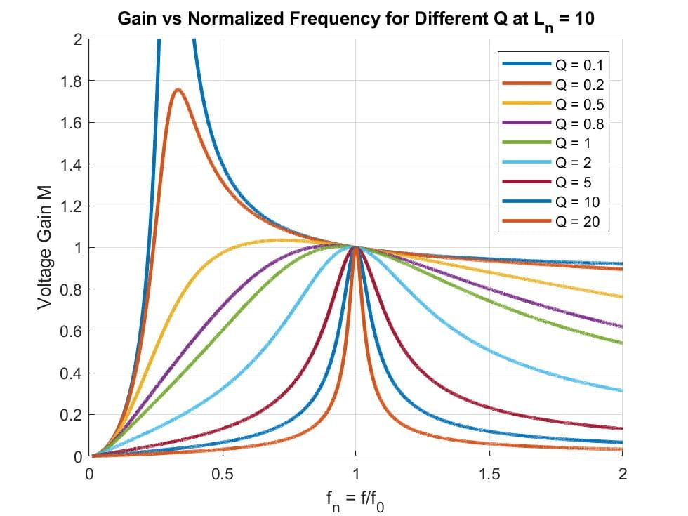
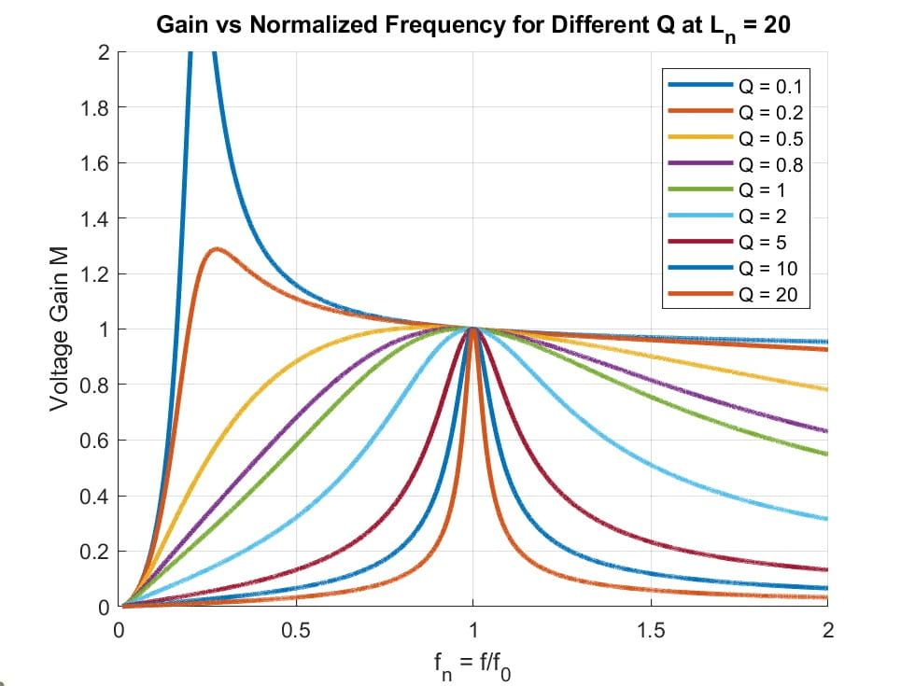

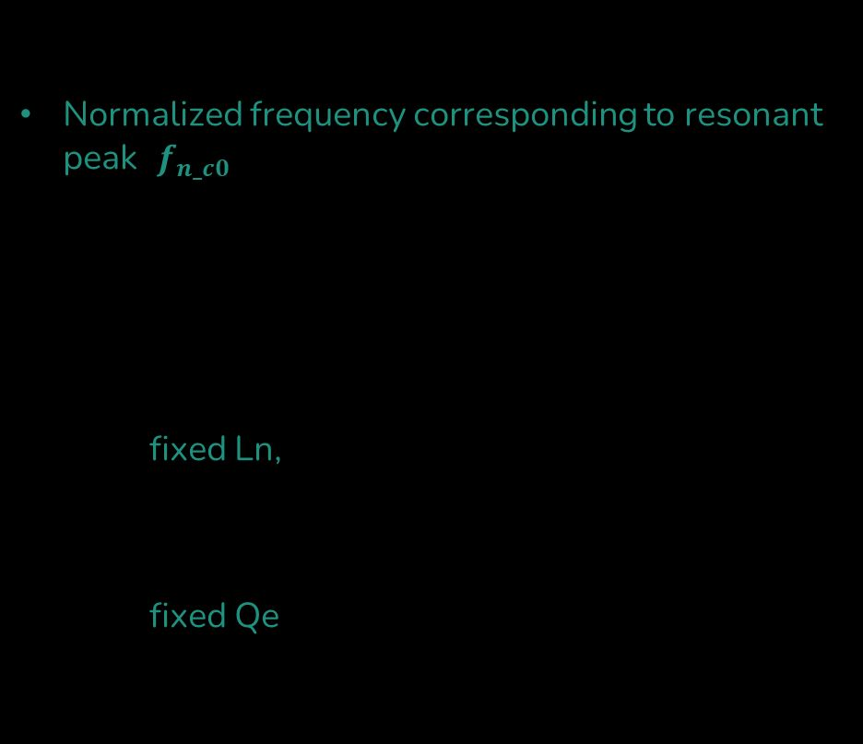



Behaviour of the LLC Voltage-Gain
Control variable - fn
Normalized frequency corresponding to resonant peak ($f_{n_c0}$) is moving w.r.t. change in load (and thus w.r.t. change in Qe)
Irrespective of comb^{n} of Qe and Ln, (Mg, fn) = (1, 1) for all curves (irrespective of the loading conditions)
For a fixed Ln, if Qe → shrinks the curve,
lowers the curve,
$f_{n_c0}$ shifts towards f0
For a fixed Qe, if Ln → shrinks the curve
${ f}_{n_c0}$ shifts towards f0
peak gain increases
$$L_{n}=1$$
$$L_{n}=5$$
$$L_{n}=10$$
$$L_{n}=20$$
Notes:
Let’s take an simple illustration,
As RL : Infinite → 0
Qe : 0 → Infinite
Mg-peak : Infinite → 1
fc0 : fp → f0
For a fixed Qe, decrease in Ln shrinks curve, the whole curve is squeezed (horizontally) and fc0 moves
towards f0. Also, peak gain increases and better freq. control band.

Slide 10




Behaviour of the LLC Voltage-Gain
Control variable - fn
Normalized frequency corresponding to resonant peak ($f_{n_c0}$) is moving w.r.t. change in load (and thus w.r.t. change in Qe)
Irrespective of comb^{n} of Qe and Ln, (Mg, fn) = (1, 1) for all curves (irrespective of the loading conditions)
For a fixed Ln, if Qe → shrinks the curve,
lowers the curve,
$f_{n_c0}$ shifts towards f0
For a fixed Qe, if Ln → shrinks the curve
${ f}_{n_c0}$ shifts towards f0
peak gain increases
$$L_{n}=1$$
$$L_{n}=5$$
$$L_{n}=10$$
$$L_{n}=20$$
Notes:
Let’s take an simple illustration,
As RL : Infinite → 0
Qe : 0 → Infinite
Mg-peak : Infinite → 1
fc0 : fp → f0
For a fixed Qe, decrease in Ln shrinks curve, the whole curve is squeezed (horizontally) and fc0 moves
towards f0. Also, peak gain increases and better freq. control band.

Slide 11
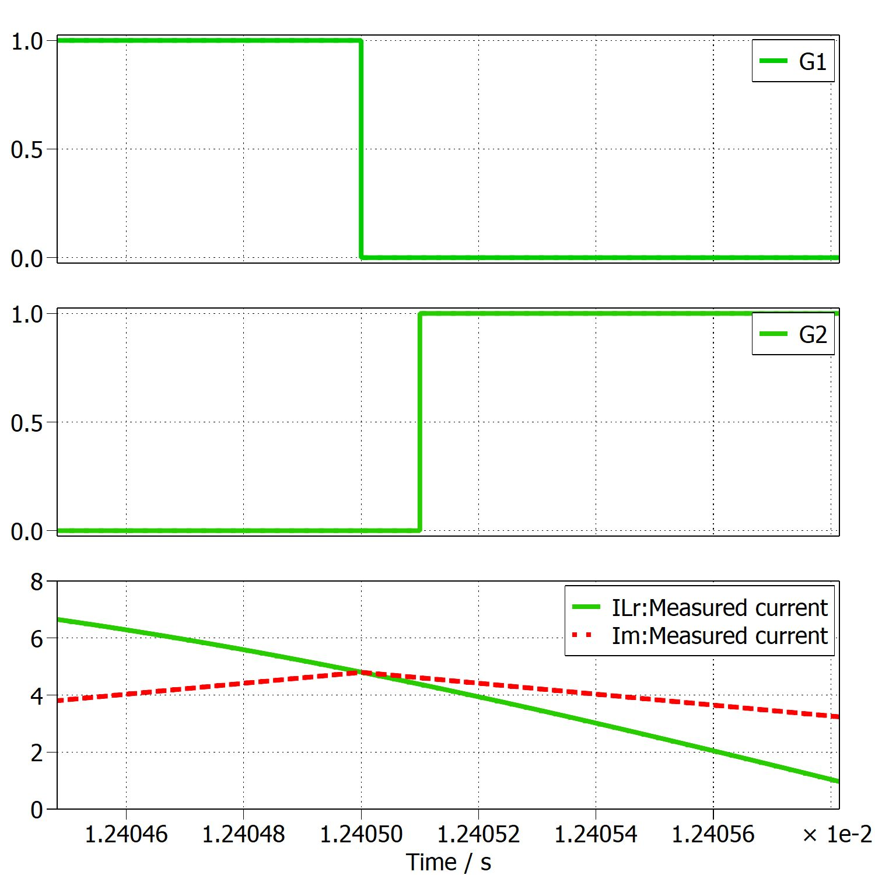
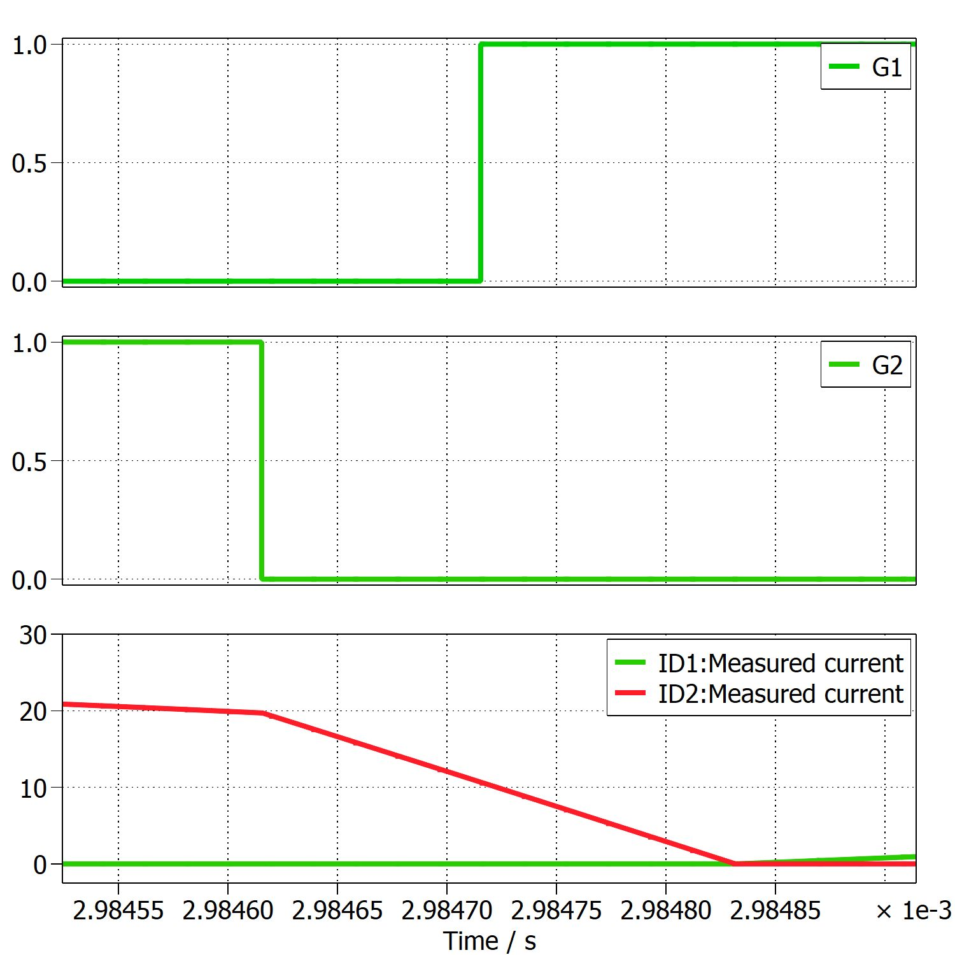
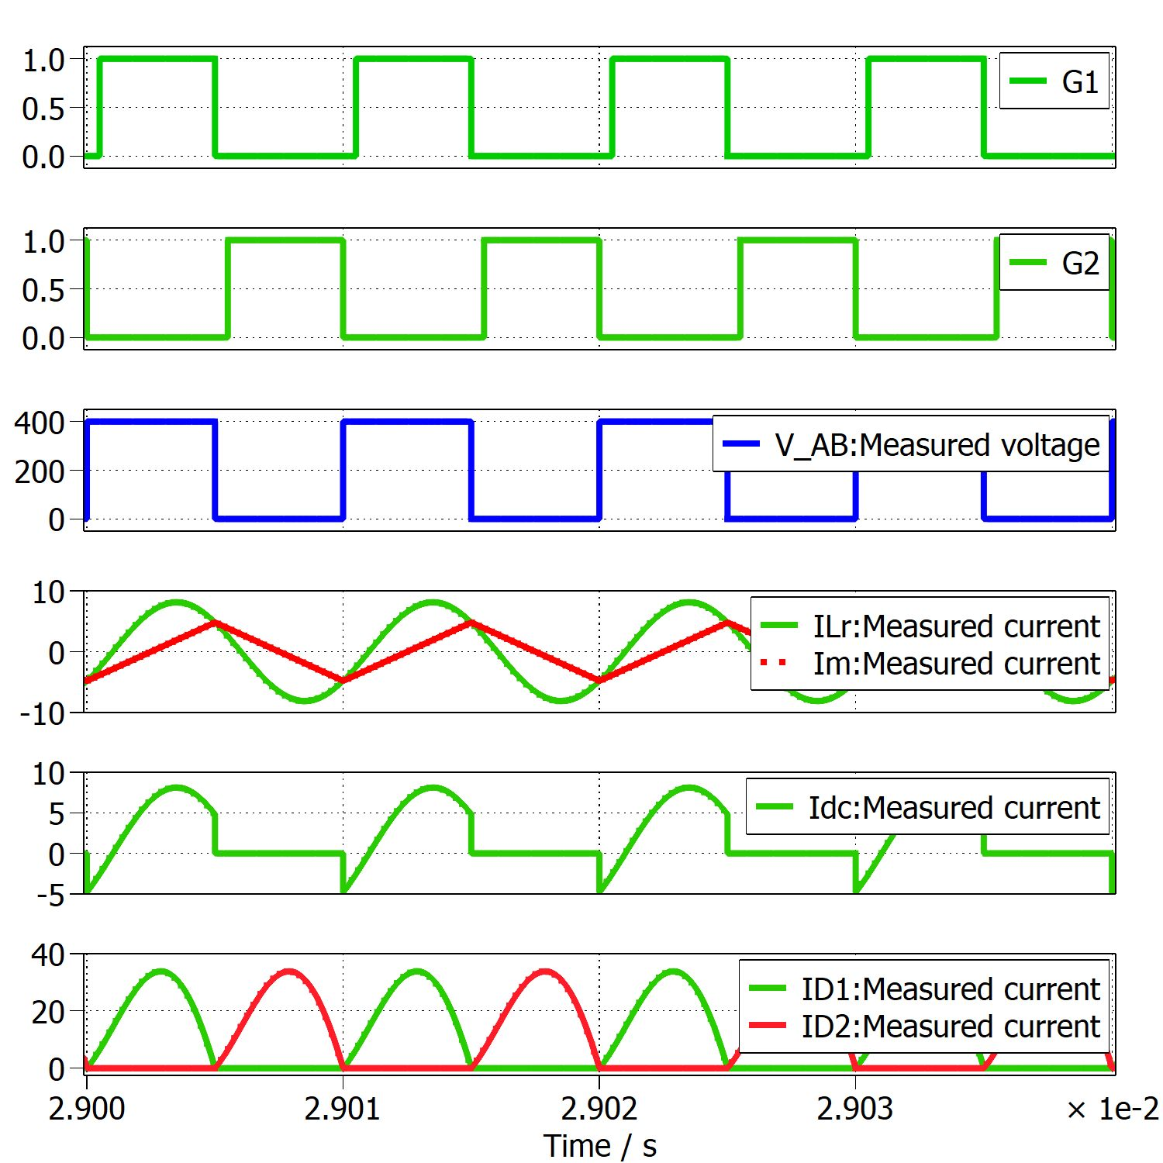
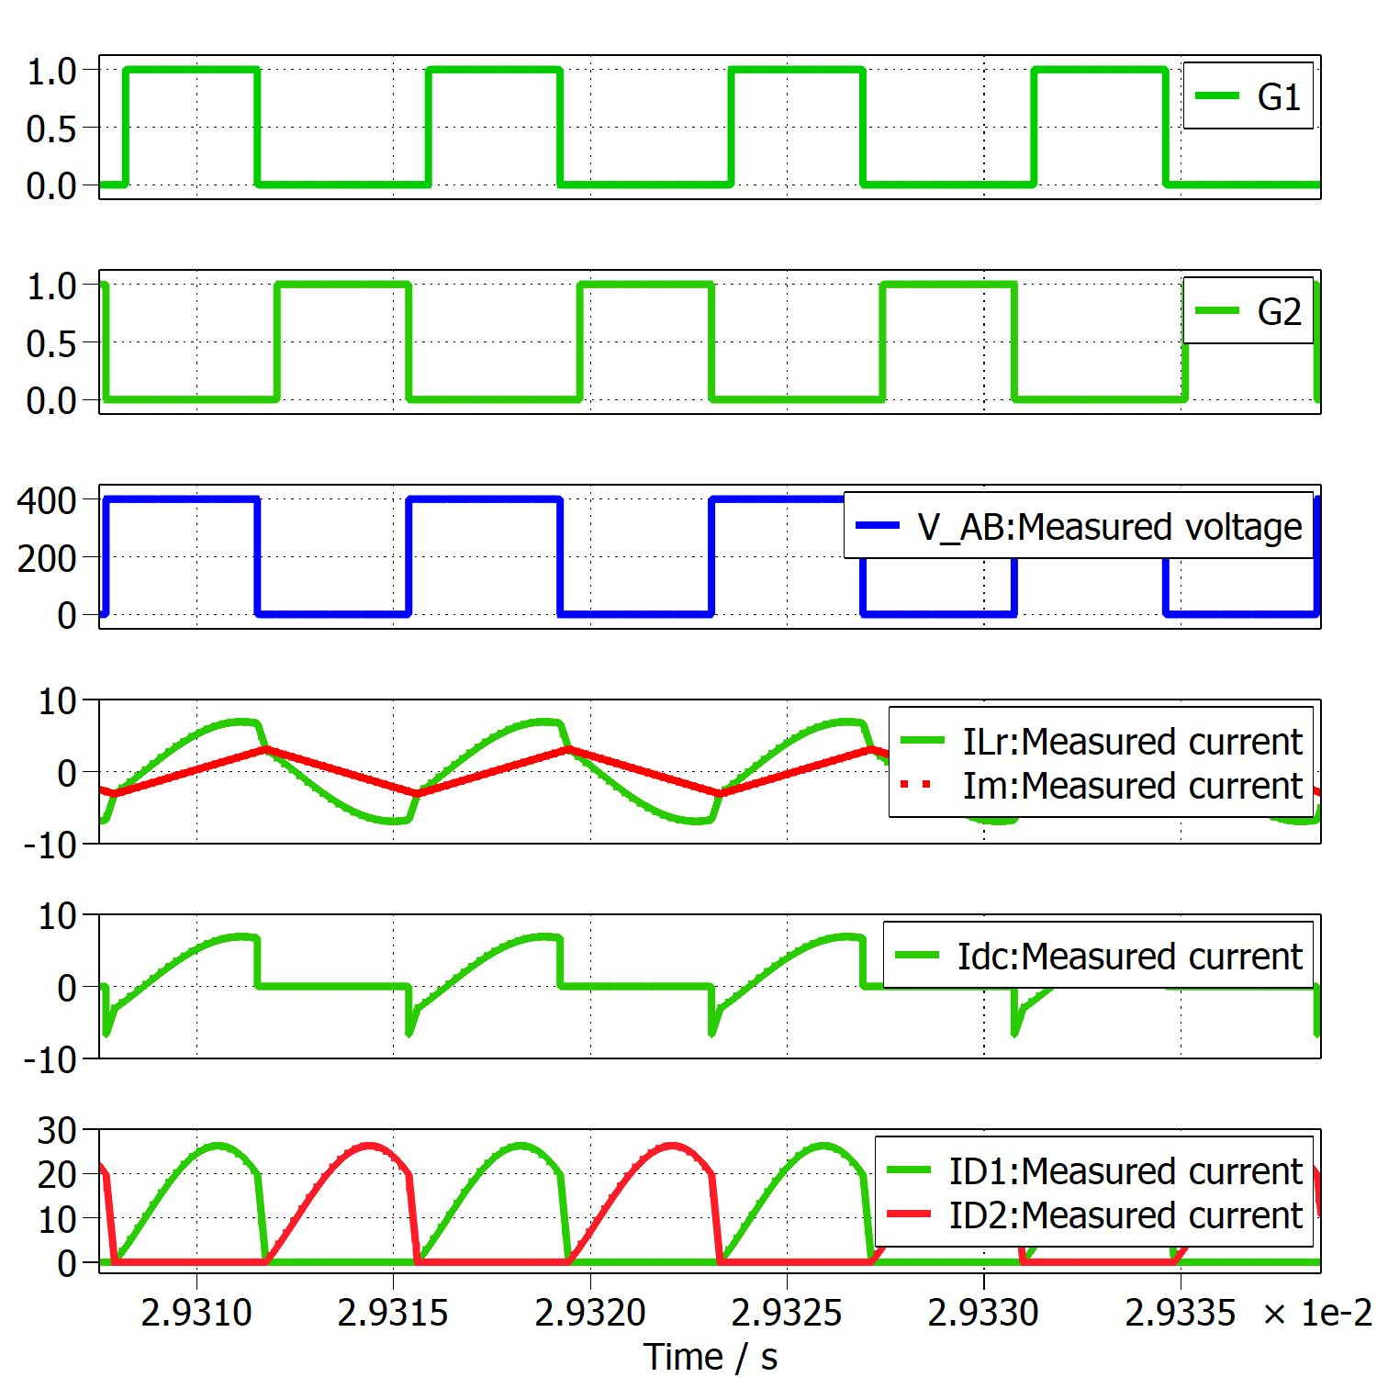
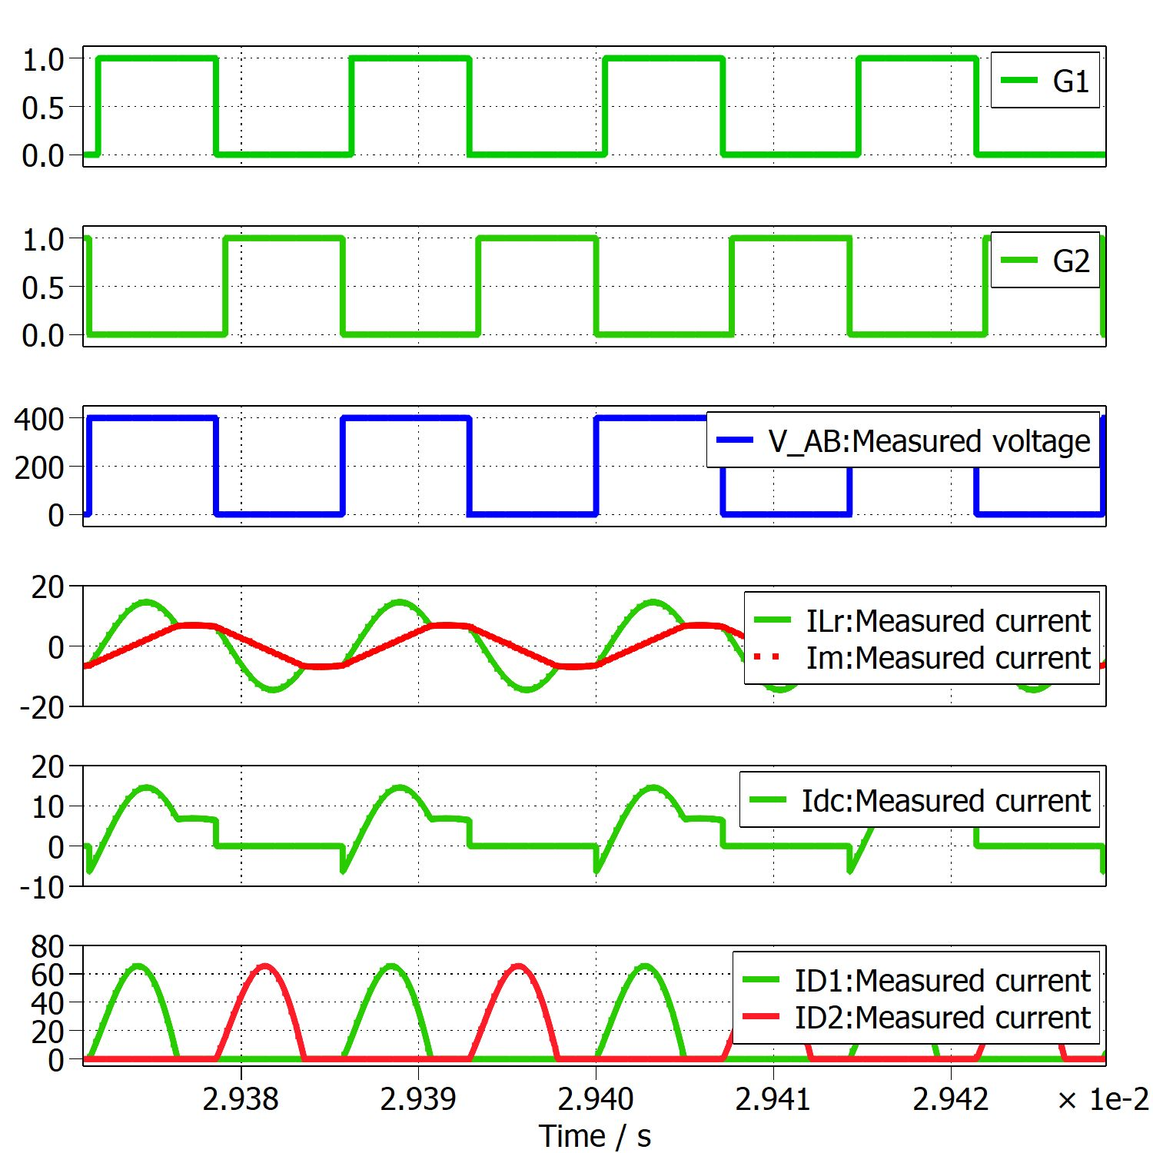
Modes of Operation
At fr
Above fr
Below fr

Slide 12
Operation at Resonance
When Q1 turns off,
Ir falls to Im
So, no power transfer to secondary side.
By delaying Q2 turn on,
we can achieve primary ZVS,
Soft commutation of rectifier diodes on secondary side.
Operation Above Resonance
ILr is in CCM
Less RMS current is required for same energy to load
Less conduction losses
Still primary ZVS is achieved.
Rectifier diode – Not soft comm^{n}
Operation Below Resonance
ILr falls to Im before the end of driving pulse,
So power transfer is stopped even before even though Im continues.
Still achieve primary ZVS and soft commutation of rectifier diodes.
Diodes – DCM. So, require more circulating current to deliver the same energy to load
which results in more conduction loss
If fsw << f0 : ZVS may be lost

Slide 13
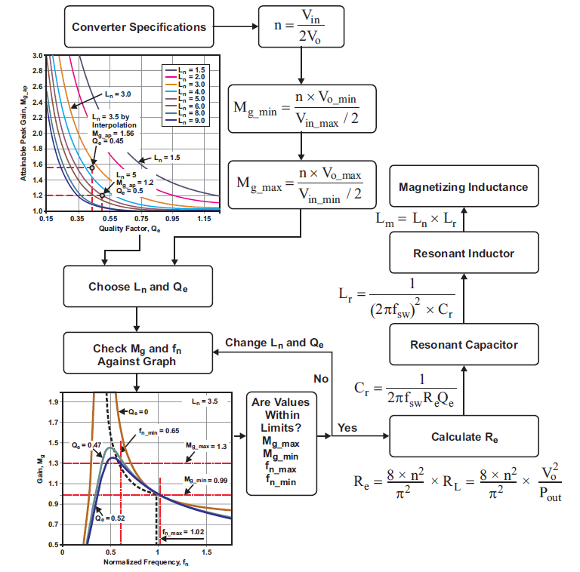
Design Considerations
Image Source: TI Power supply design seminar, Literature number SLUP263

Slide 14
Design Steps

Slide 15
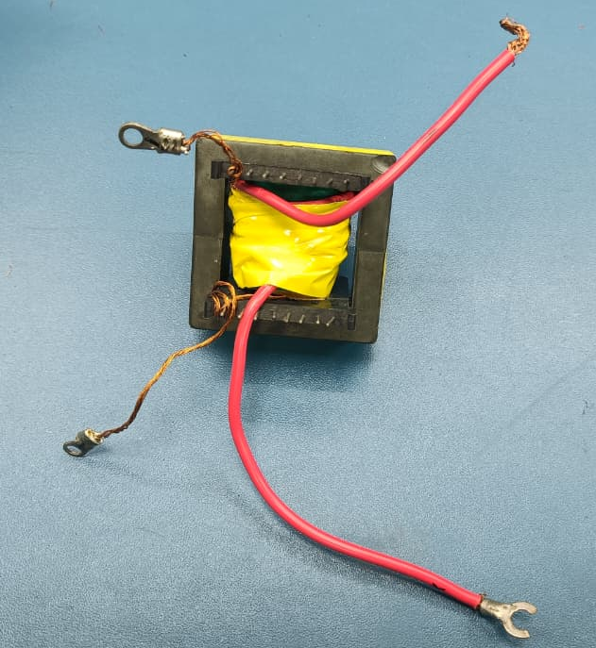

Transformer Characterization (5:1)
Open Circuit Test
LV Energized : Lp = 178.60 µH
Rp = 350 mΩ
HV Energized : Lp = 3.78 mH
Rp = 9.27 mΩ
Short Circuit Test
LV Energized : Ls = 1.08 µH
Rs = 23.01 mΩ
HV Energized : Ls = 24.62 µH
Rs = 1.2 mΩ
Lr = 24.62 µH
Lm = 3.78 mH
$L_{n}= \frac{L_{m}}{L_{r}}=153.53$ (very high)

Slide 16
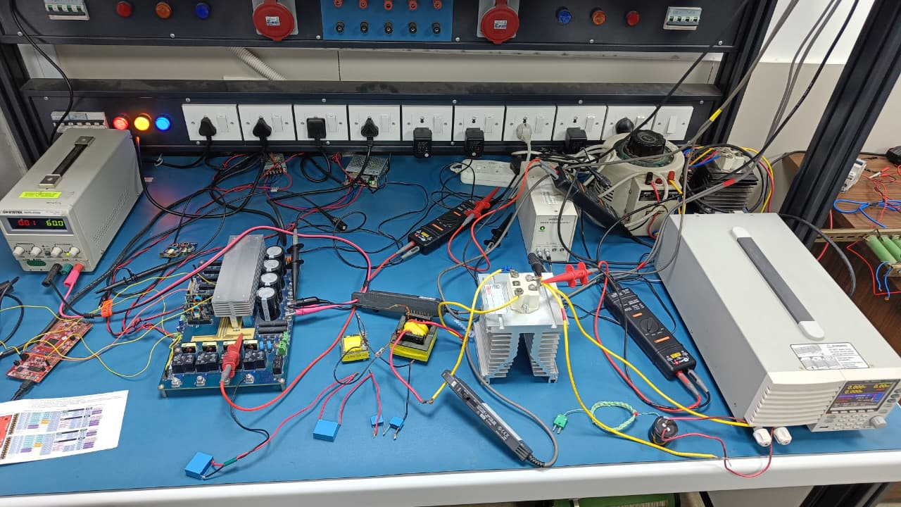
Experimental Setup
Specifications
Nova board – used as inverter
IGBTs - IKW25N120H3
Additional Inductor – 775.28 µH, 5A
Capacitor – 481.67 nF, 288 nF (Bipolar)
Electronic Load – 2 Ω
Microcontroller – TMS320F28379D

Slide 17
Experimental Setup
Specifications
Nova board – used as inverter
IGBTs - IKW25N120H3
Additional Inductor – 775.28 µH, 5A
Capacitor – 481.67 nF, 288 nF (Bipolar)
Electronic Load – 2 Ω
Microcontroller – TMS320F28379D

Slide 18
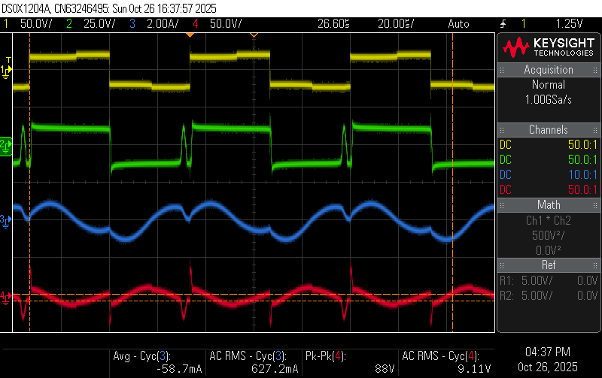
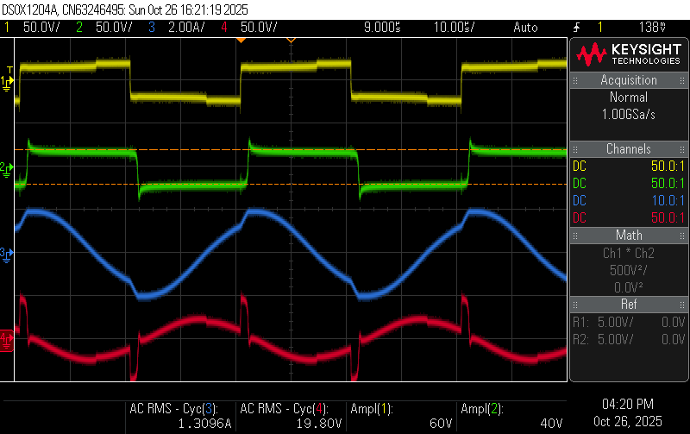
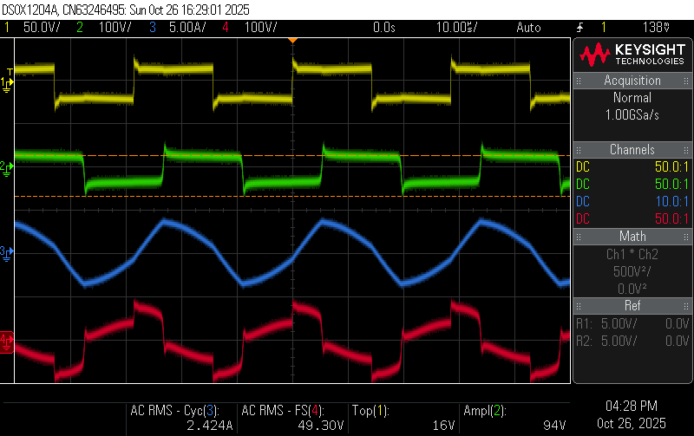
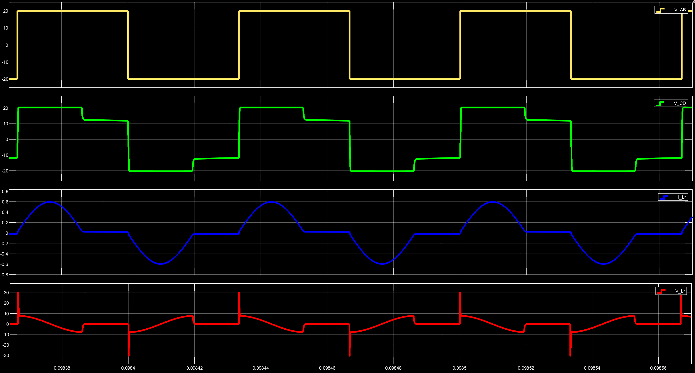
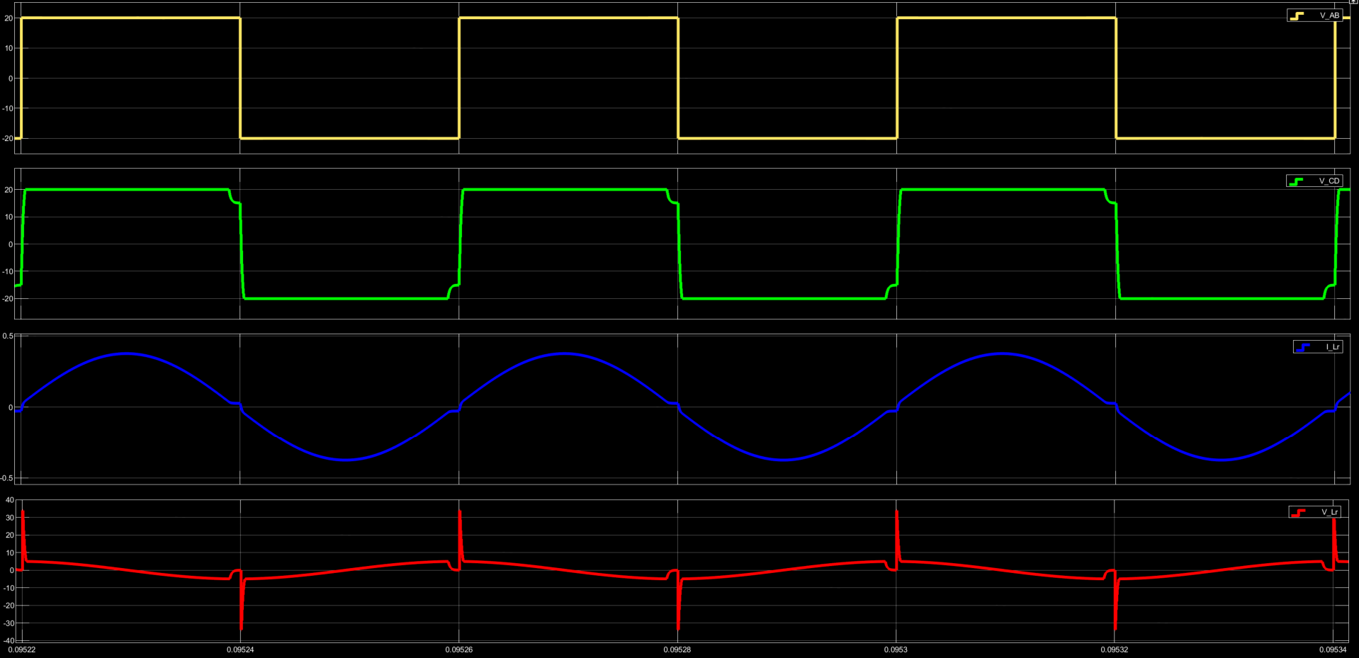
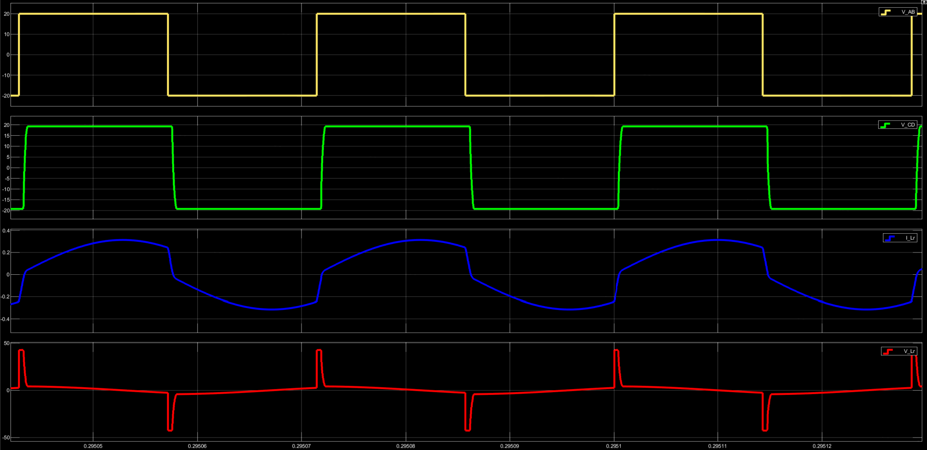
DC-DC Series Resonant Inverter (SRC)
VAB, VCD, ILr, VLr
Observations
15 kHz – Discontinuous conduction mode
Highest output voltage doesn’t necessarily occur at fr
Inductor voltage spikes are more at 35 kHz
Irregularity – At 35 kHz, inductor current trend
- At 15 kHz VCD glitches
fsw = 15 kHz
fsw = 25 kHz
fsw = 35 kHz

Slide 19
DC-DC Series Resonant Inverter (SRC)
VAB, VCD, ILr, VLr
Observations
15 kHz – Discontinuous conduction mode
Highest output voltage doesn’t necessarily occur at fr
Inductor voltage spikes are more at 35 kHz
Irregularity – At 35 kHz, inductor current trend
- At 15 kHz VCD glitches
fsw = 15 kHz
fsw = 25 kHz
fsw = 35 kHz

Slide 20
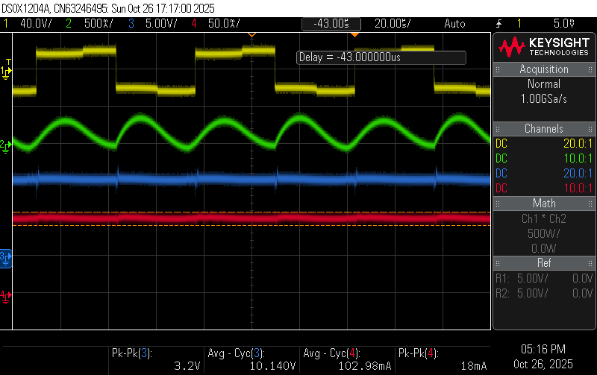
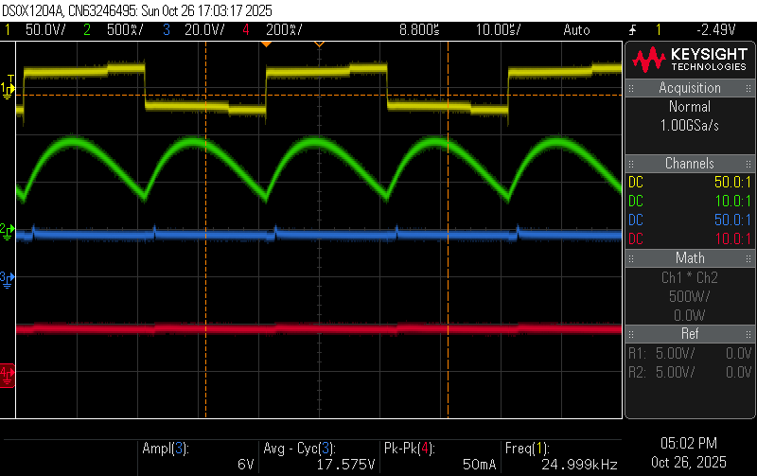
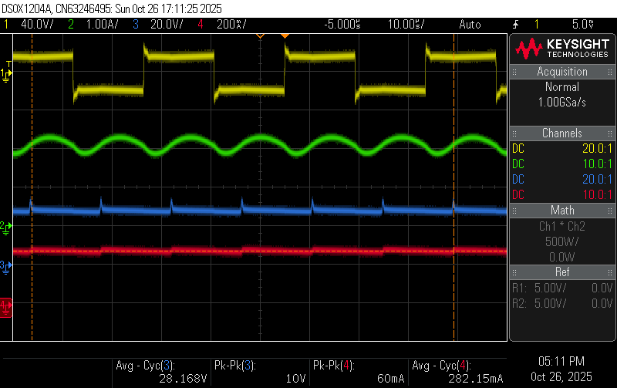
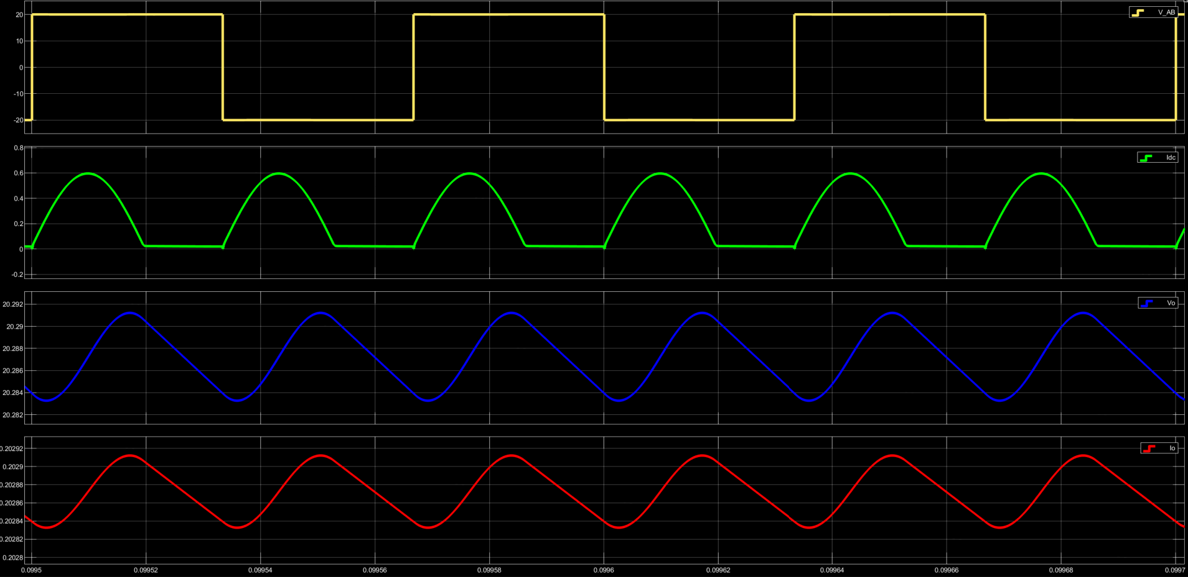
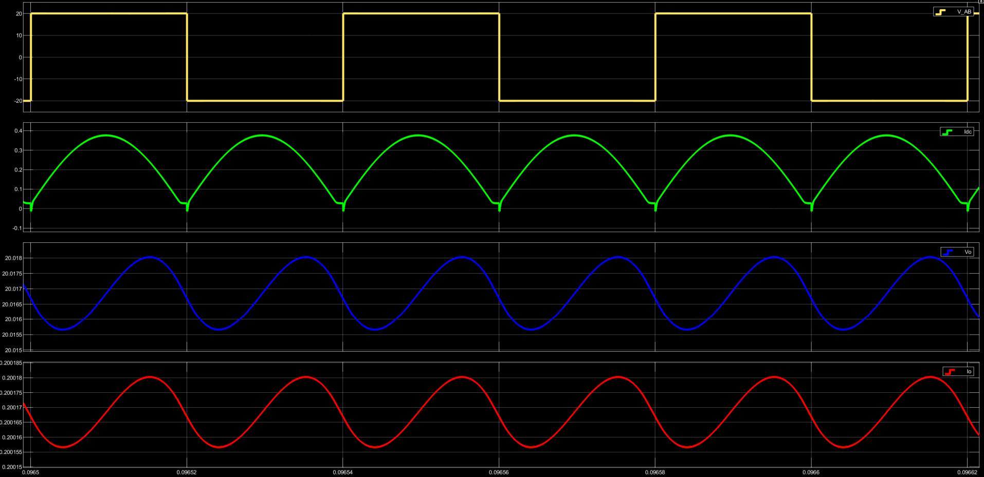
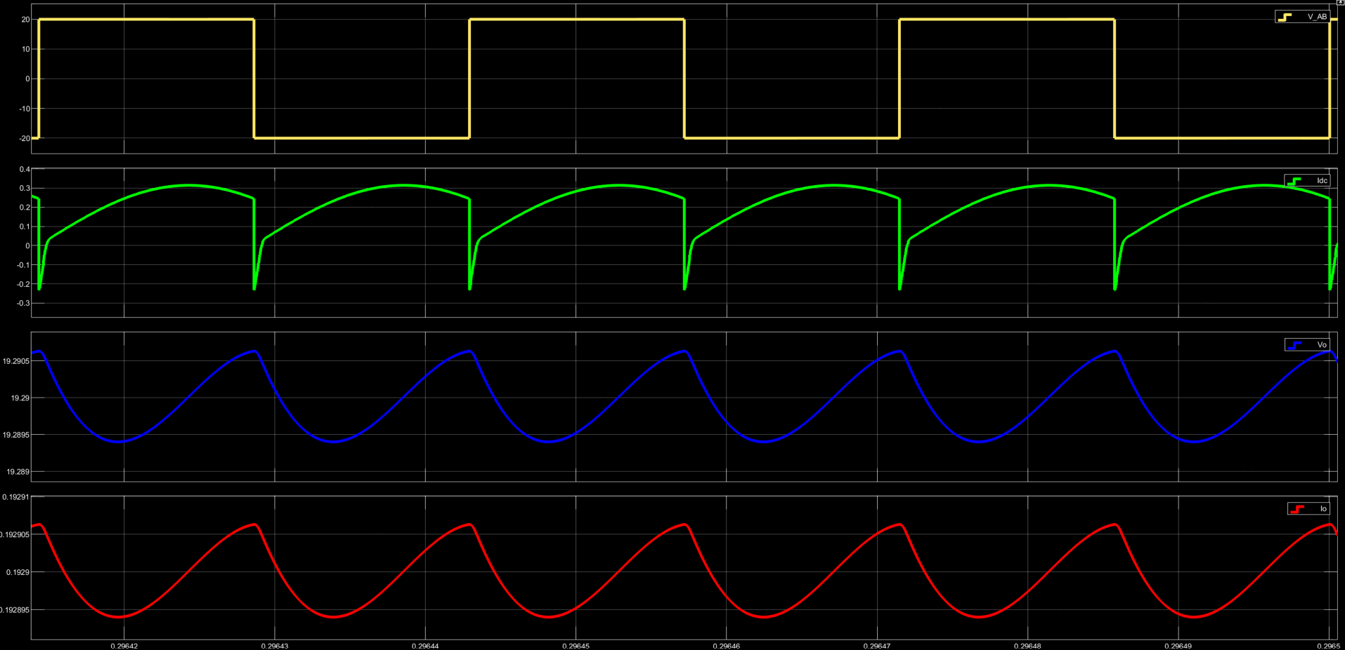
DC-DC Series Resonant Inverter (SRC)
VAB, Idc, Vo, Io
fsw = 15 kHz
fsw = 25 kHz
fsw = 35 kHz

Slide 21
SRC Converter - Experimental Results
fsw = 15 kHz
fsw = 25 kHz
fsw = 35 kHz

Slide 22
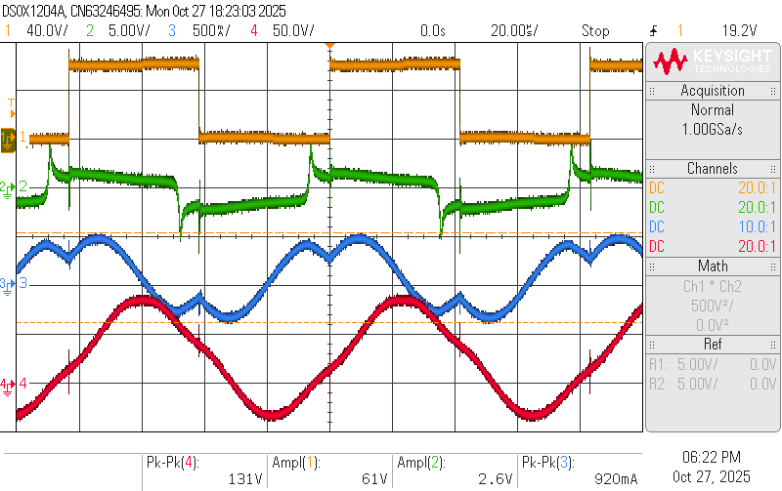
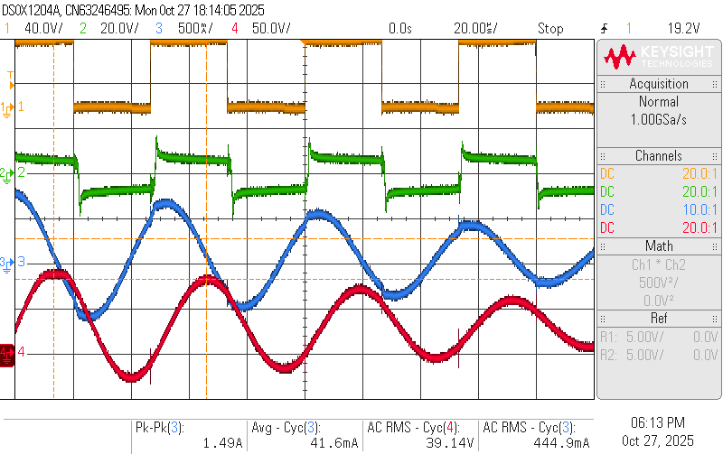
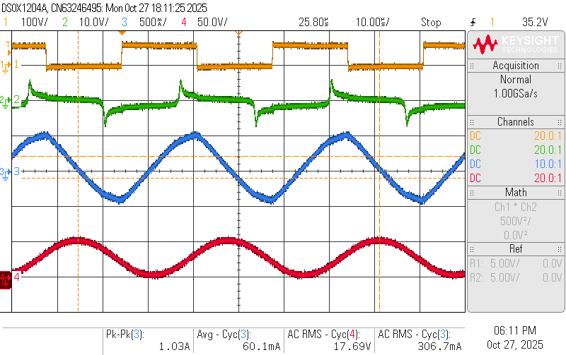
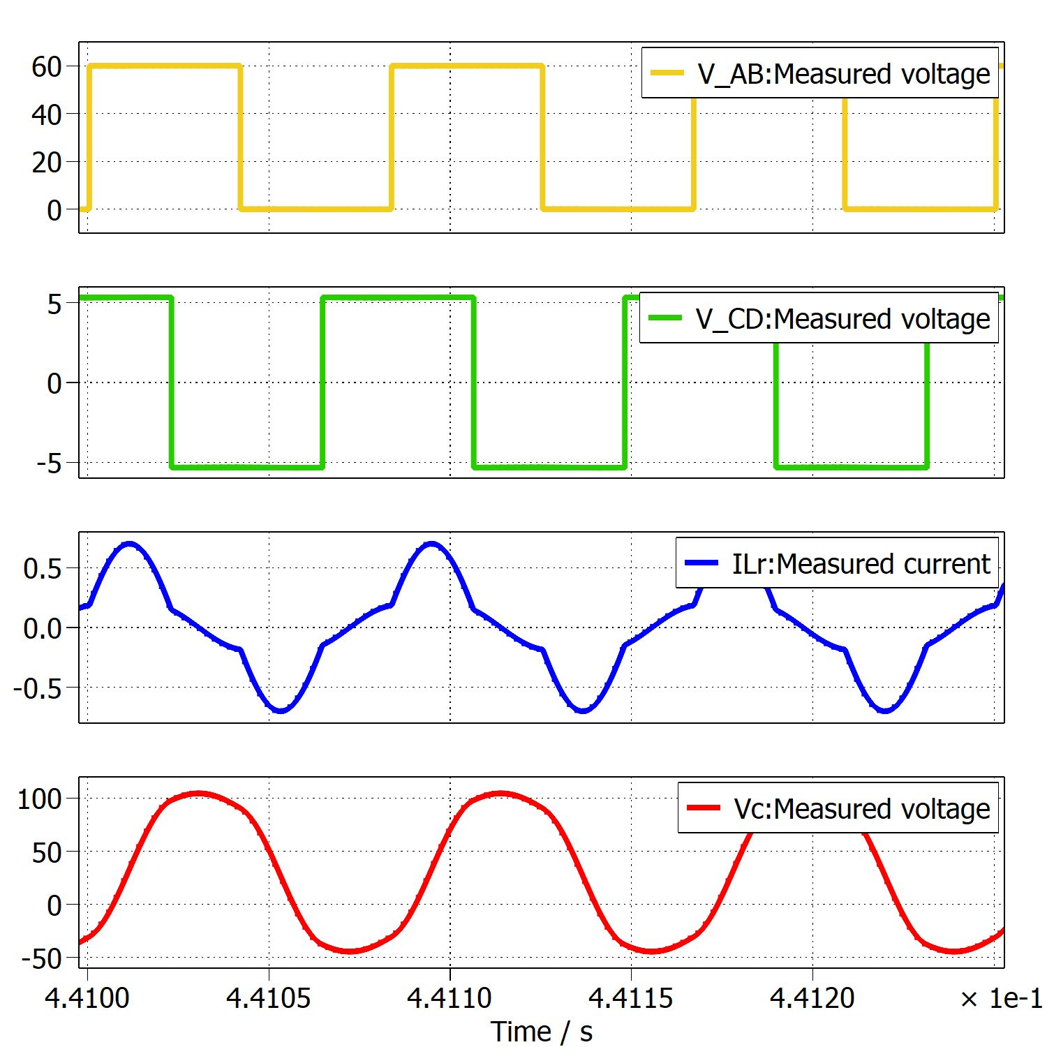
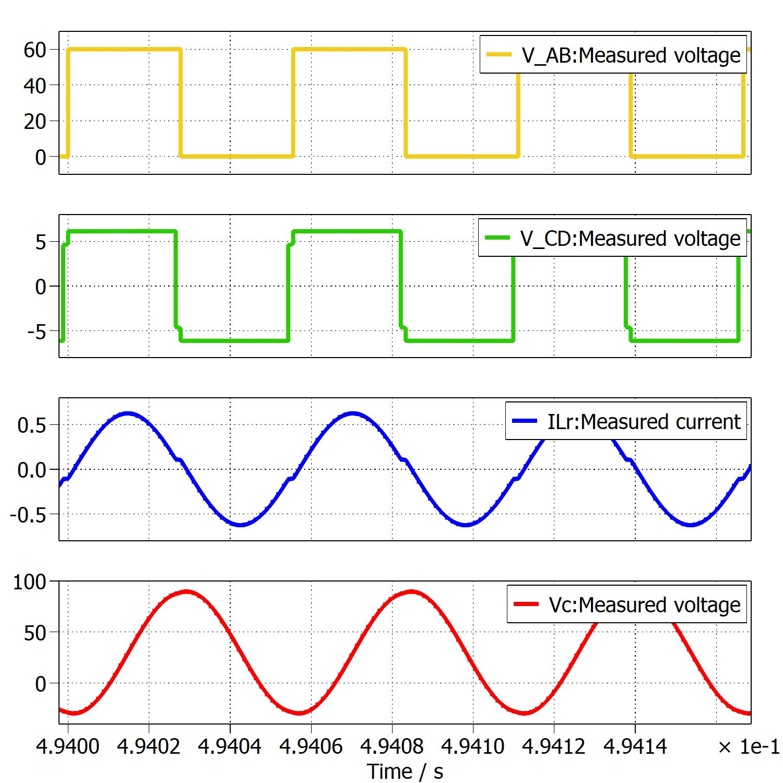
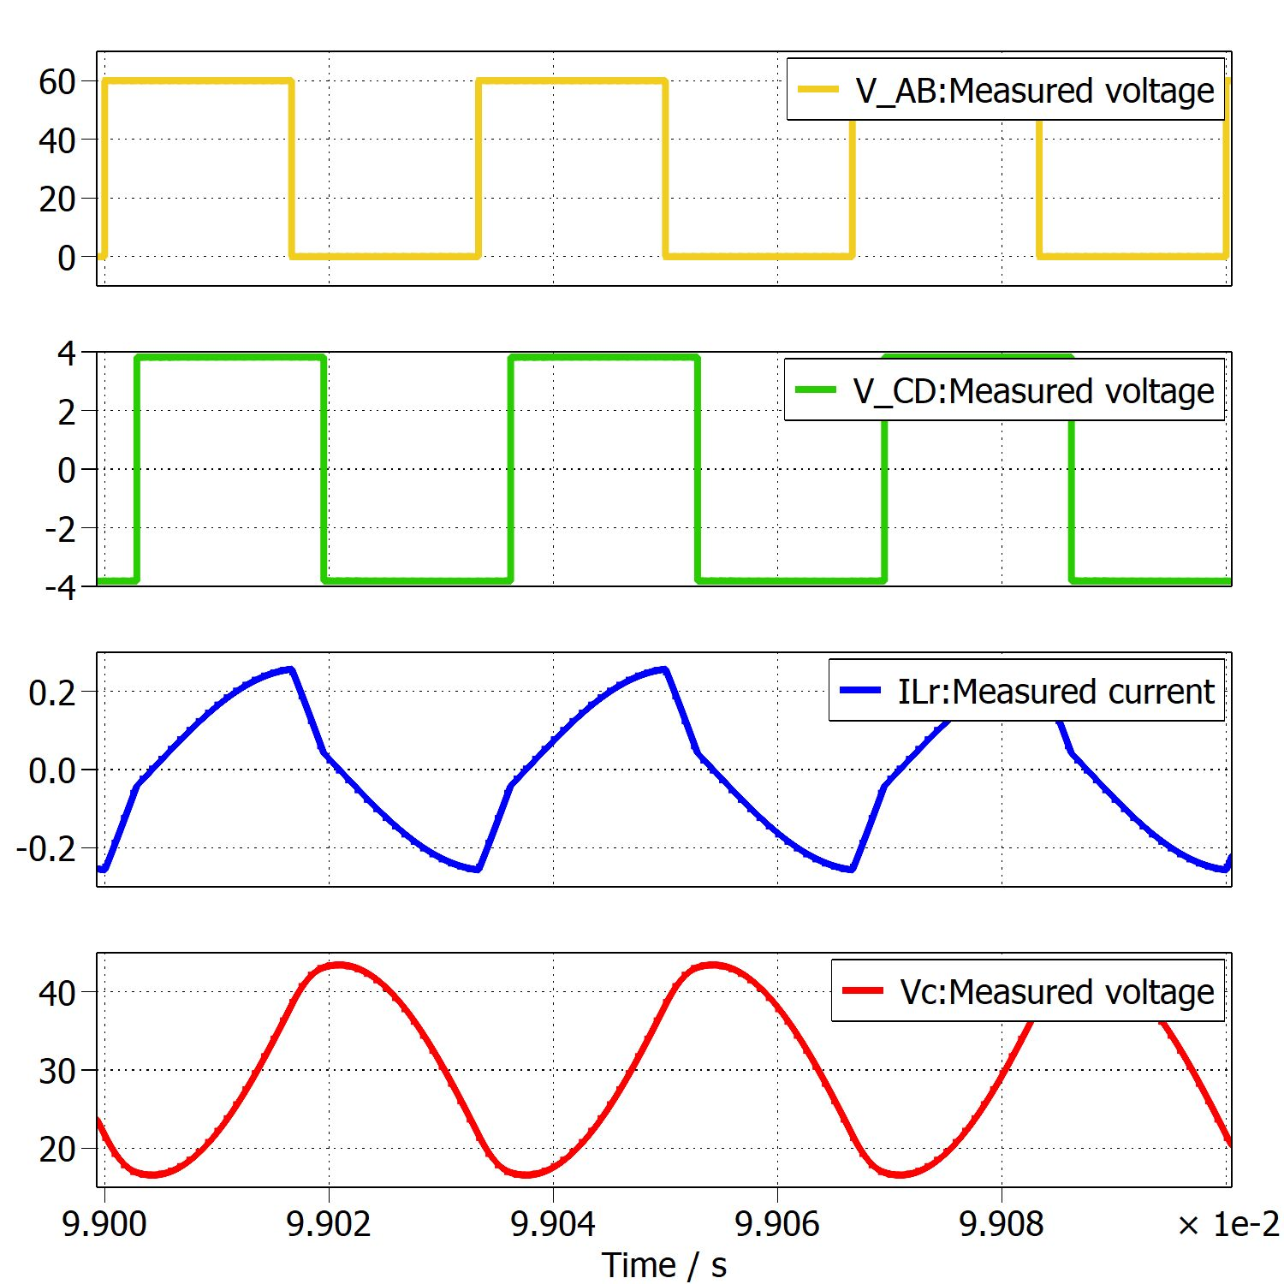
LLC Resonant Converter
VAB, VCD, ILr, VLr
Some Observations
12 kHz – No discontinuous conduction
(No DCM even at low fsw)
At fr and more than fr, results are closely matching
As fsw is increased, VCr is reduced
Irregularity – Simulation is not able to mimic behaviour at low switching frequencies
fsw = 12 kHz
fsw = 18 kHz
fsw = 30 kHz

Slide 23
LLC Resonant Converter
VAB, VCD, ILr, VLr
Some Observations
12 kHz – No discontinuous conduction
(No DCM even at low fsw)
At fr and more than fr, results are closely matching
As fsw is increased, VCr is reduced
Irregularity – Simulation is not able to mimic behaviour at low switching frequencies
fsw = 12 kHz
fsw = 18 kHz
fsw = 30 kHz

Slide 24
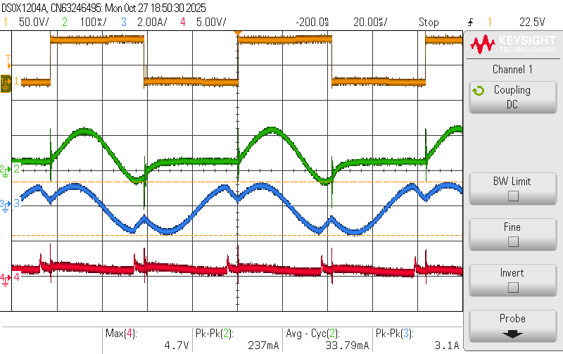
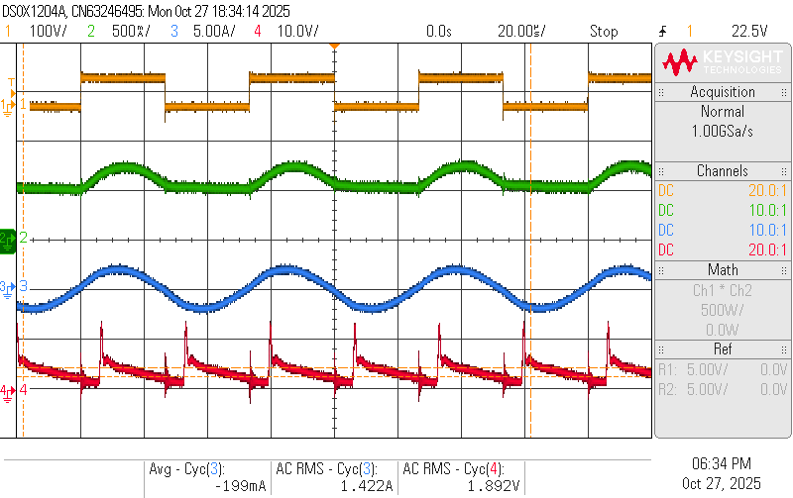
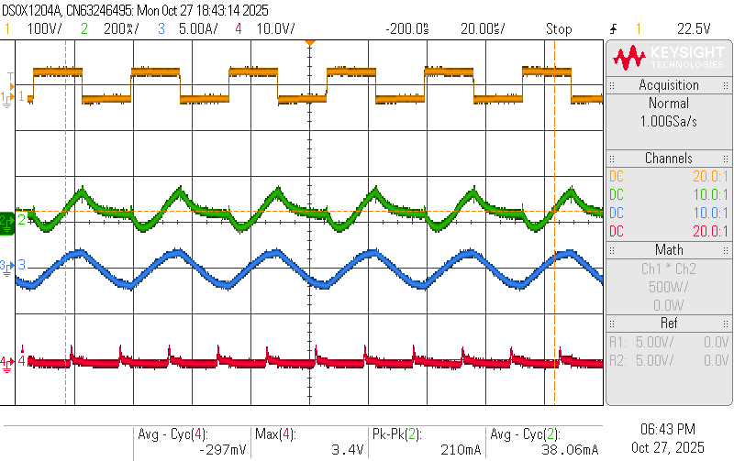
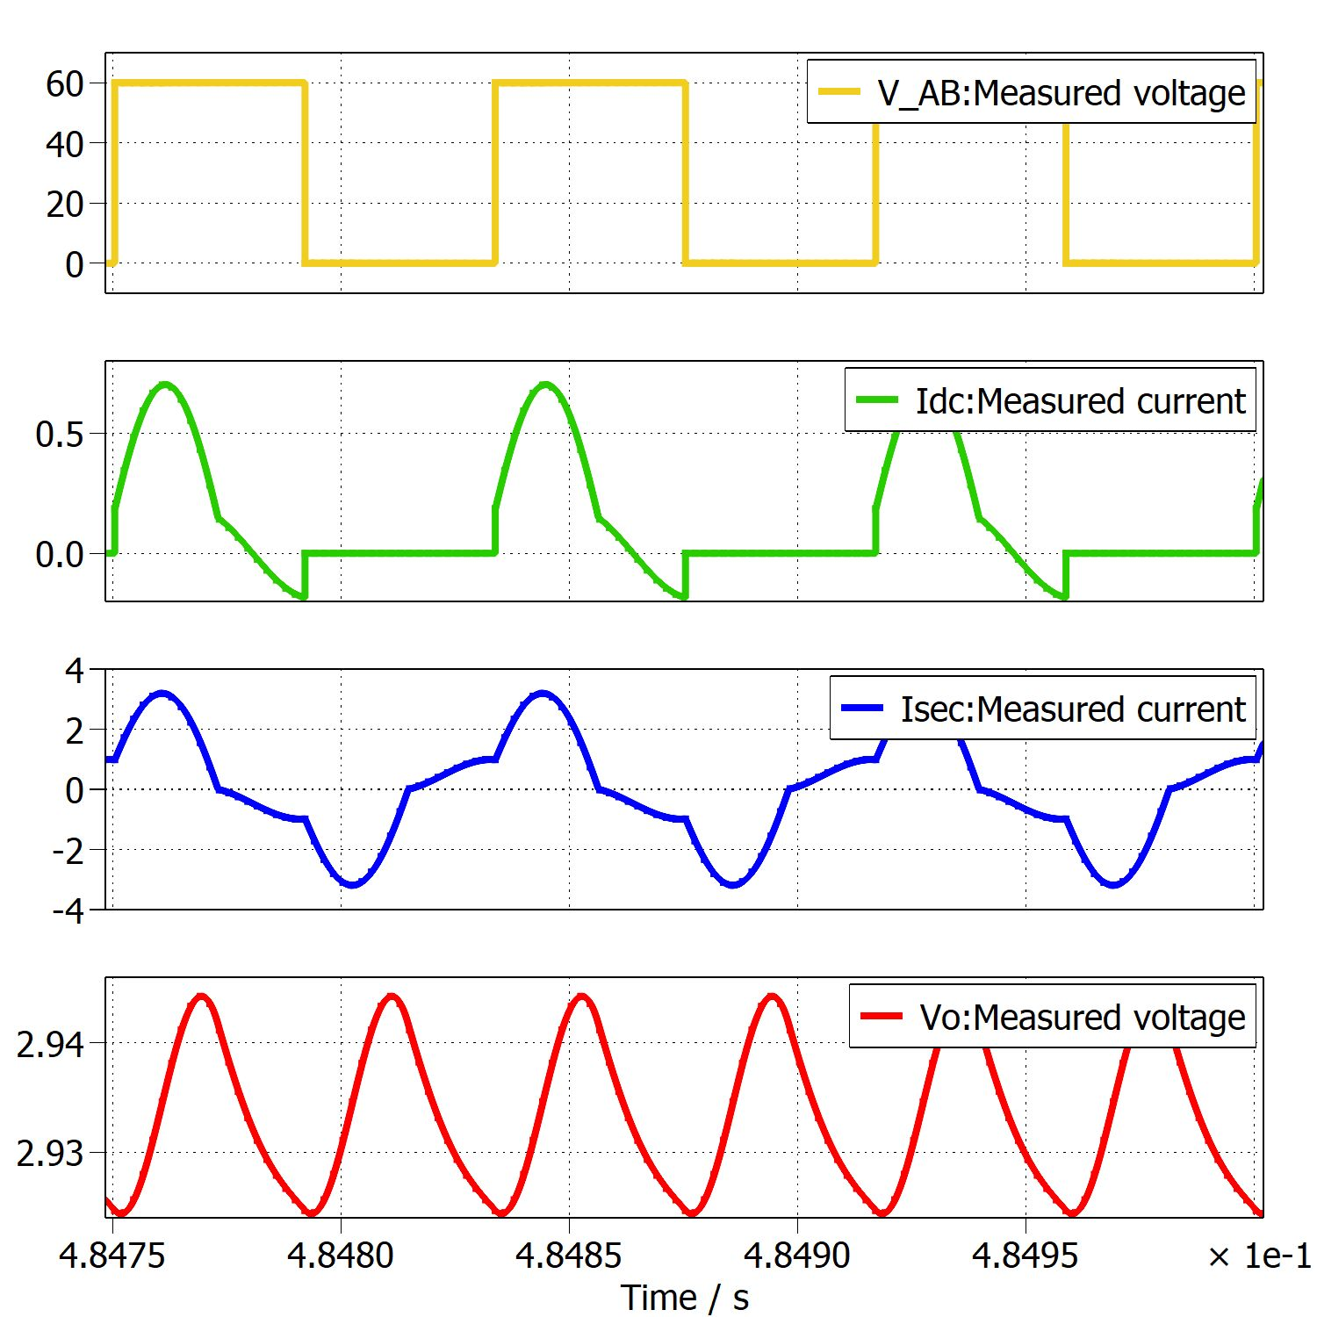
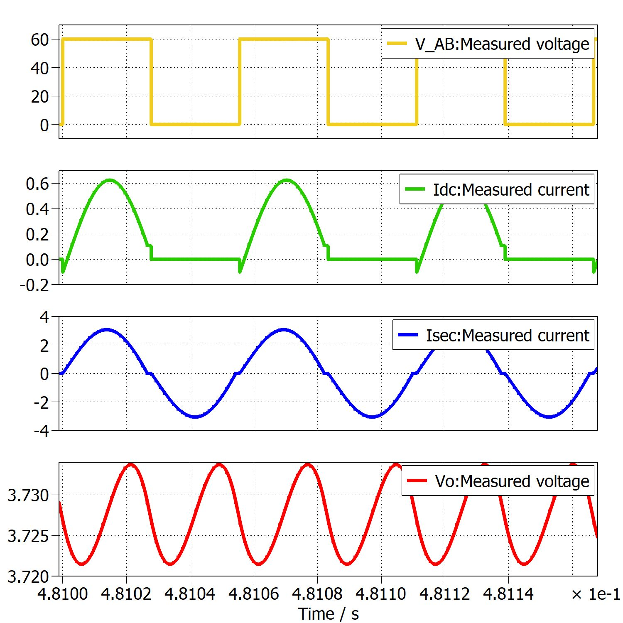
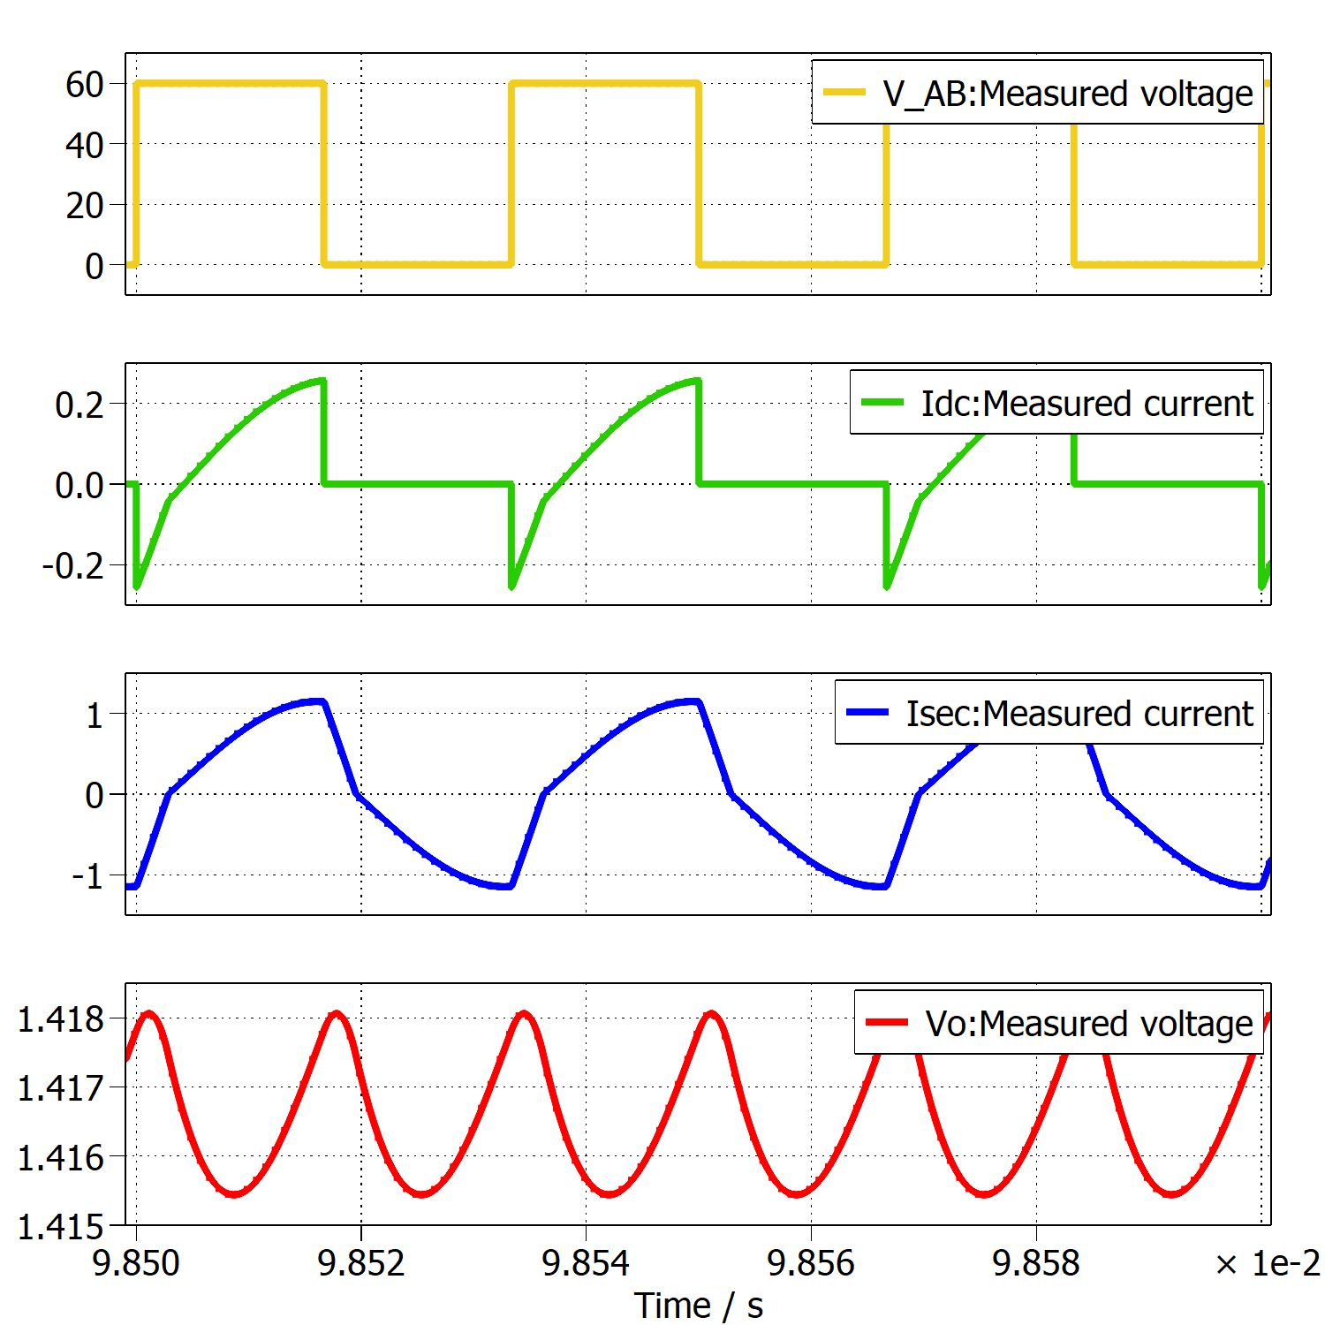
LLC Resonant Converter
VAB, Idc, Isec, Vo
fsw = 12 kHz
fsw = 18 kHz
fsw = 30 kHz

Slide 25
LLC Converter - Experimental Results
fsw = 12 kHz
fsw = 18 kHz
fsw = 30 kHz

Slide 26
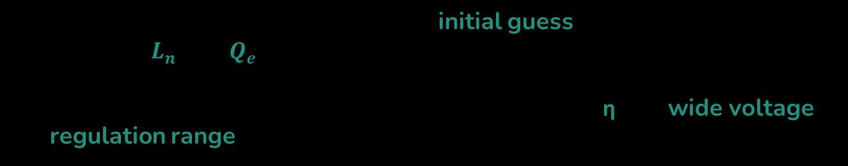
Key Takeaways and Conclusion
Based on domain knowledge, some initial guess has to be taken between $L_{n}$ and $Q_{e}$ selection as a starting point in converter design
Generally, there is a trade-off is observed between η and wide voltage regulation range
Future Work
Moving to 1 kW, 400V – 48V LLC resonant converter hardware and closed loop control

Slide 27
Thank You

Slide 28


PRC and LLC Readings
 | At fr | Above fr | Below fr
PRC | 1.52 A | 1.08 A | 2.5 A
LLC | 1.25 A | 0.428 A | 1.402 A
PRC | 0.8 A | 0.474 A | 1.18 A
LLC | 0.22 A | 0.066 A | 0.294 A
$$I_{Lr}$$
$$I_{parallel}$$

Slide 29
Feedback
Why there is a dip in VCD at 15 kHz in SRC ?
and why it is not at fr or > fr ?
Why ILr is not in DCM in hardware, but its in DCM in simulation ?
Why we are not in DCM even at very low fsw ?

